Slide 1

How does a bike-share navigate speedy success ?
Presented by: Atreyee Joardar
Last Updated: June 23rd, 2024

Slide 2
01
Purpose
02
Story
CONTENTS
03
Conclusion
04
Recommendations

Slide 3


01
Purpose
Identify trends how casual riders and member riders use bikes differently and provide recommendations to convert casual riders into annual members

Slide 4
02
Story
Finding patterns
Analyzing trends

Slide 5
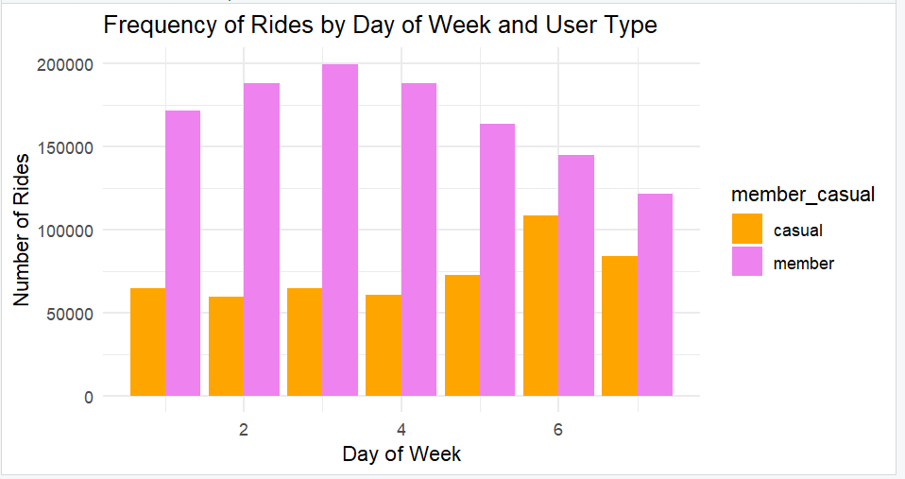
It is evident that casual riders have more number of rides on weekends that is on Friday and Saturday(6 & 7).
Whereas member riders have consistent usage throughout the week.

Slide 6
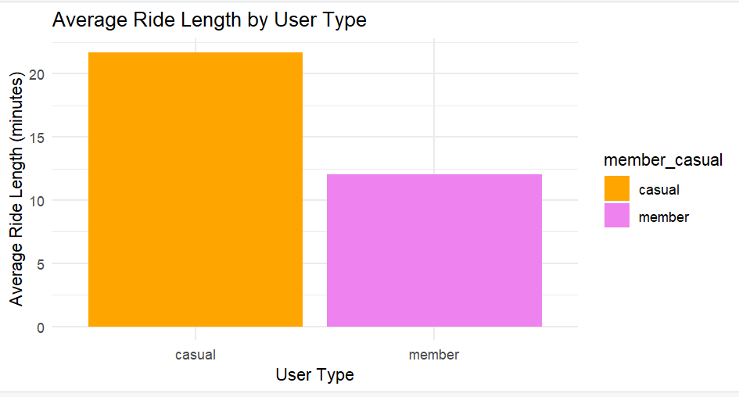
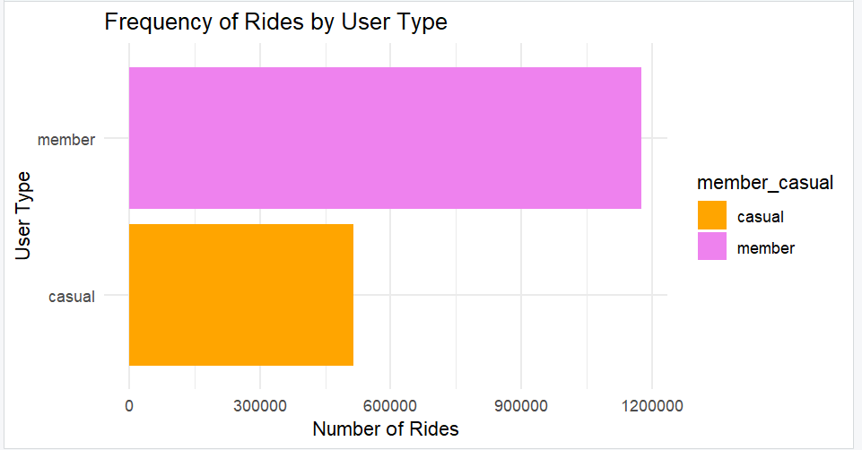
It is observed that the casual riders ride for a longer period but are not frequent riders(around 500,000 rides).
The member riders uses bikes for a shorter length but their frequency of using bike is much more(over 1000000 rides).

Slide 7
03
Conclusion

Slide 8
From the previous three graphs the followoing conclusions are made :
It may demonstrate that the casual riders rent a bike for leisure time for trips and long drives because they rent less frequently but rent it for a longer period and they rent it mostly on weekends.
It might also reveal that the member riders use the bikes for their regular needs or official purposes as it is observed that they use it in a consistent manner throughout the week.

Slide 9
04
Recommendations

Slide 10
Recommendation 1
Send notifications whenever they make a payment for their trip and explaining them in brief how much money they could have saved for this particular trip if they were a member rider.
Recommendation 2
Provide exclusive offers for the member riders especially on weekends because the number of casual riders are more on weekends so that they get enticed by the offers and decides to get a membership. Provide offers on the first trip for a new member to tempt them even more.
Recommendation 3
Provide variety of membership like for three mnths, six months. And also provide dual membership facility and show the benifits to the customers so that the one person convinces his/her friend to take a membership.

Slide 11

THANKS

